Slide 1


Drone Multi-Control Algorithm Optimization
David Soria
Andre Kahn
Mentor: Yitao Bai
Location: POB UT Austin

Slide 2
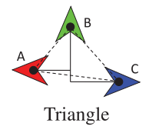
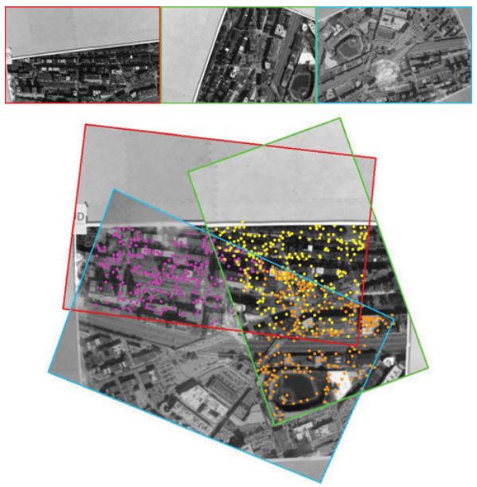
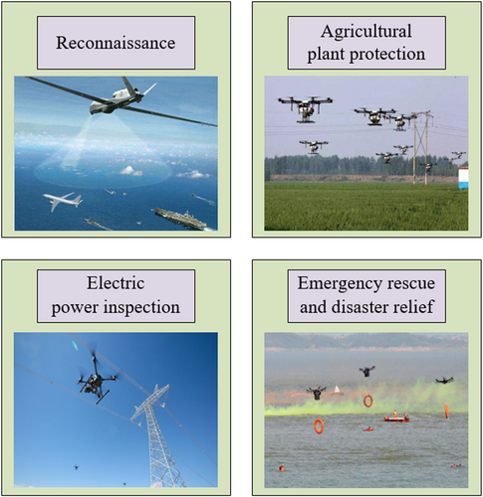
Motivation
Our project aims to develop an objective function that allows drones to maintain a desired formation while actively avoiding collisions with one another
Why do we use Multi-UAV (Unmanned Aerial Vehicle) systems?
A multi-UAV system can be utilized to solve various real-world problems
Applications include localization, mapping and navigation; search and rescue operations in hazardous environments; etc. (Fig 1)
Ex: Mapping case where three drones are formed in a triangle formation to get images to create mapping of “world” (Fig 2)
Fig 1: Examples of real-world cases for use with multi-UAV drones
Fig 2: Mapping using three drones in a triangle formation to capture a map of images

Slide 3
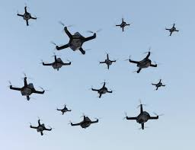
What is Formation Control?
The capability for multiple drones to self organize into coordinated formations
Maintains consistent velocities and safe distances between drones
Helps avoid inter-drone collisions
Example of a coordinated drone swarm in formation flight

Slide 4
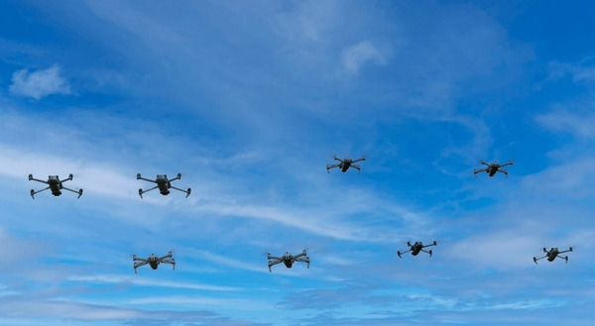


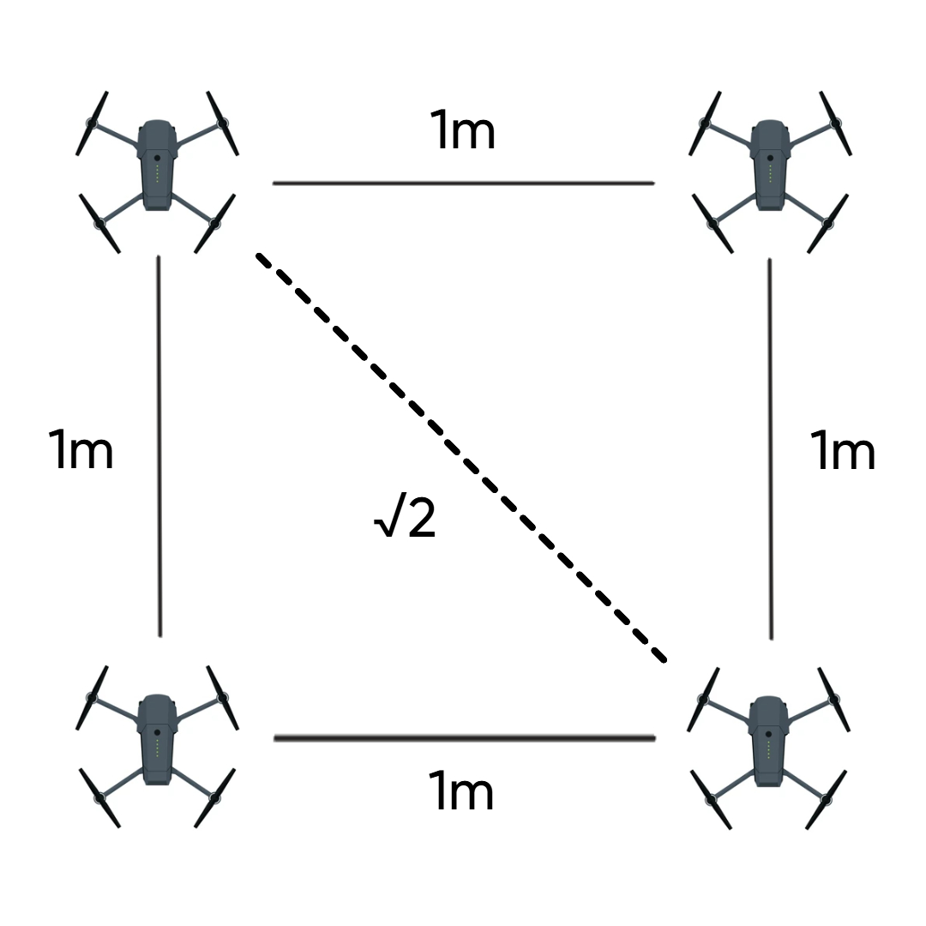
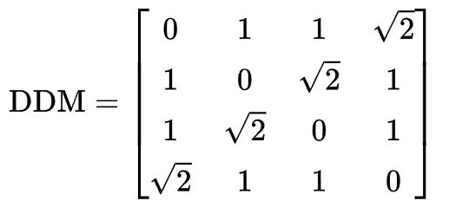
Optimizing Drone Formation
Objective Function:
The goal is to have the results of our objective function be as close to zero as possible
The function displays the sum of two convex functions, resulting in our optimal convergence as a convex as well
DDM = Desired Distance Matrix
P = positions of drone
Optimizing our objective function minimizes collisions between drones and allows drone to reach our desired square formation
Maintains safe distance between drones
Want to minimize error between target position and current position
We utilize distance-based matrices for our formation control as it is best suited for each agent to recognize its own distance to its neighbors in contrast to position-based formation control.
1
2
1 2 3 4
1
2
3
4
3
4

Slide 5
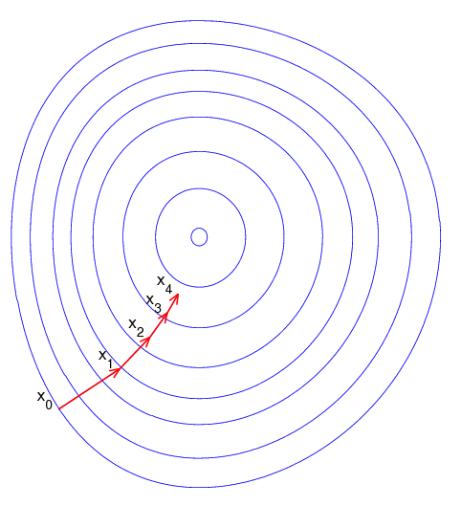
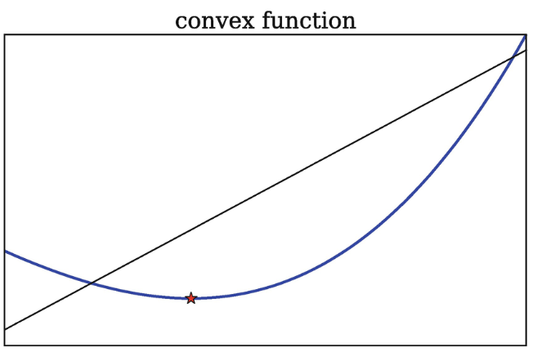
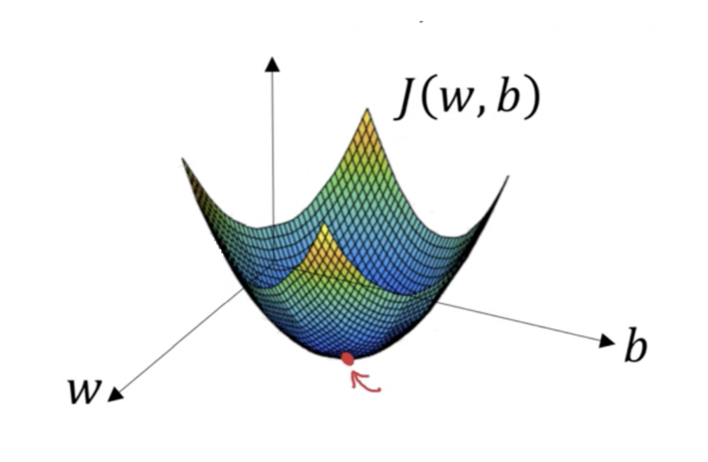
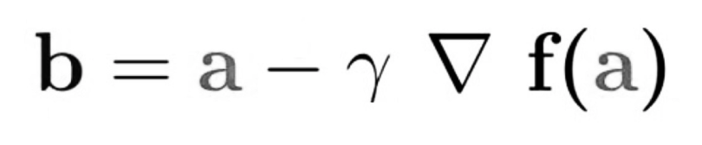
Gradient Decent Algorithms
Gradient decent is direction of quickest decrease. Algorithms use gradient decent to minimize cost function
Initialize w and b randomly
Gradient decent in direction of quickest decrease
Most efficient path to point of zero increase (or minimum of cost function)
b = direction needed to go for steepest decent
a = current position
ϓ = step size (scalar)
∇f(a) = gradient function

Slide 6

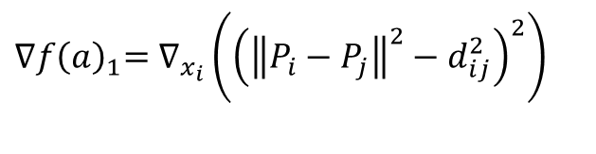
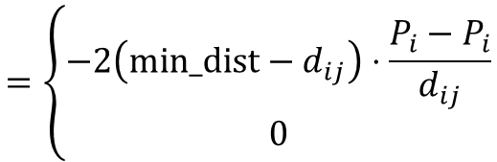

Our Gradient Function
${∇f\left(a\right)}_{1}=∇_{x_{i}}\left({\left({\left\|P_{i}−P_{j}\right\|}^{2}−d_{ⅈj}^{2}\right)}^{2}\right)$
$= 4\left({\left\|P_{i}−P_{j}\right\|}^{2}−d_{ⅈj}^{2}\right)\left(P_{i}−P_{j}\right)$
$${∇f(a)}_{2}={\left(\max\left(min⁡_dist−\left\|P_{i}−P_{j}\right\|,0\right)\right)}^{2}$$
$$=\left\{\begin{aligned}−2\left(min_dist−d_{ij}\right)⋅\frac{P_{i}−P_{i}}{d_{ij}} \\ 0\end{aligned}\right.$$
If $d_{ij}<min⁡_dist$
otherwise
Target Position equation

Slide 7
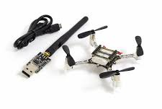
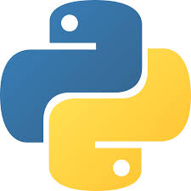

Method
Develop control algorithm for swarm drone control
Implement control strategies in simulation
Utilize PID controller for drones to adjust position/ avoid collision
Software/Hardware
PyBullet
CrazyFlies
Python

Slide 8
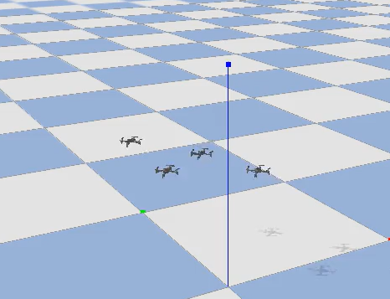

Implementation: Simulation
Example of UAV Square Formation using PID control and our objective function
We used PyBullet Physics Engine to run a realistic simulation
The optimization control is based on an algorithm using gradient descent
A key part of our implementation is the repulsive force
If any two drones get too close, this force pushes them away from each other
Fig 1: Standard Gradient Control
Fig 2: Collision Avoidance

Slide 9
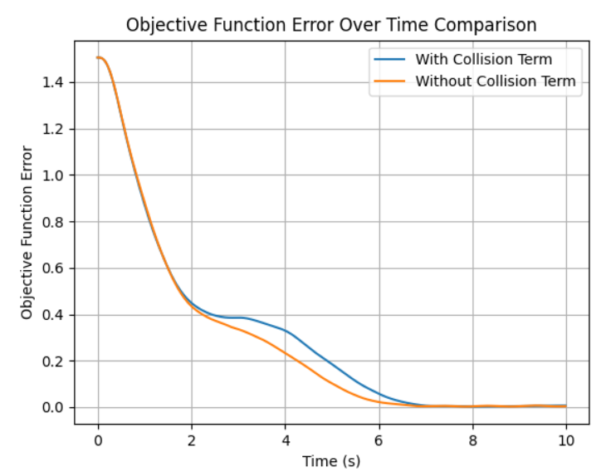
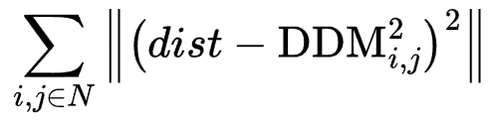
Results: Simulation
Plots displaying our objective functions value as it changes over time
With our collision avoidance term
Without collision avoidance term
This method proves that our objective function still converges to our optimal value at a slightly slower rate

Slide 10
Conclusion
Summary
We successfully implemented an objective function that allowed us to guide drones into a desired formation automatically
Tested approach displayed stable formation maintenance and improved safety
Future Work
Extend to real life test-bench and bridge the Sim2Real gap
Cooperative multi-agent reinforcement learning to improve our optimization policy
Key Takeaway
Safe and coordinated drone formations can be achieved through distance-based formation control for reliable multi-drone missions

Slide 11
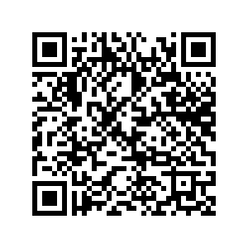
References
Thank You!!
Questions?

